Slide 1
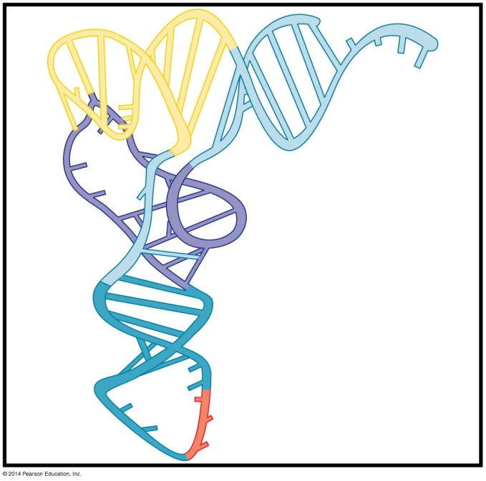
The Genetic Code
BT 454
Chapter 16

Slide 2
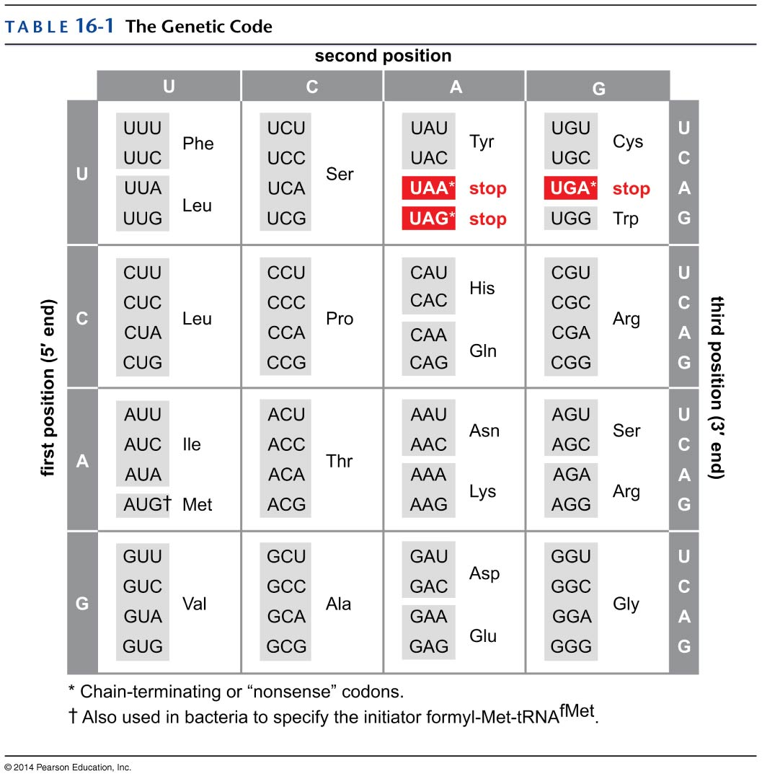
The code is degenerate
Degeneracy: many amino acids are specified by more than one codon
Codons specifying the same amino acid are Synonyms
Usually degeneracy is based on equivalence of first two nucleotides
In the 3rd position U/C & A/G are interchangeable
Notes:
The frequent third-place eqivalence of the four NTPs explains how there can be great variation in the AT/GC ratios in the DNA of various organisms without correspondingly large changes in the relative proportion of amino acid in their proteins.

Slide 3
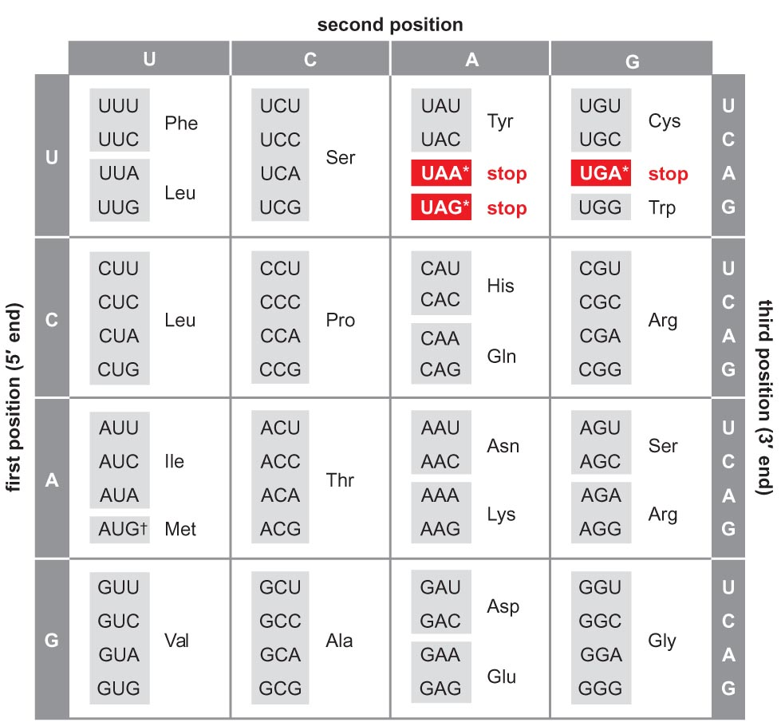
Mutation effect is minimized by code rules
Mutation in first position gives similar/same aa
Mutation in third position rarely changes aa
First two codons G or C, the 3rd codon rarely affect a.a
Transition mutation in second position replace a.a with very similar one
  Codons with pyr (C/U) → hydrophobic aa
  Codons with Pur (G/A)→ polar aa

Slide 4
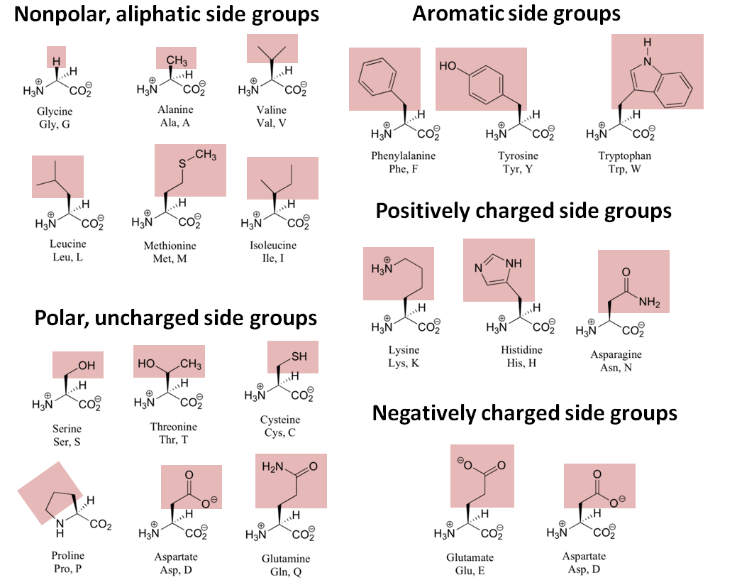

Slide 5
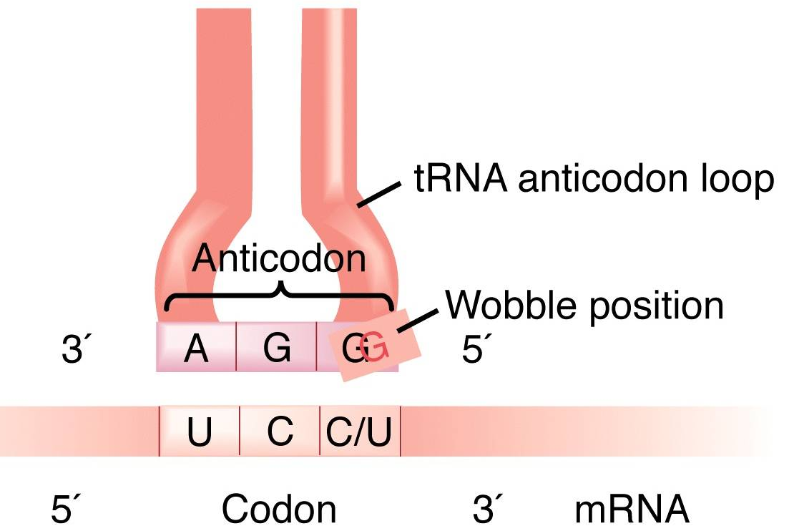
Wobble in the anticodon
3rd position at 3` end of codon in mRNA is the 1st at 5` end of anticodon in tRNA
Pairing at the wobble position is restricted to rules

Slide 6
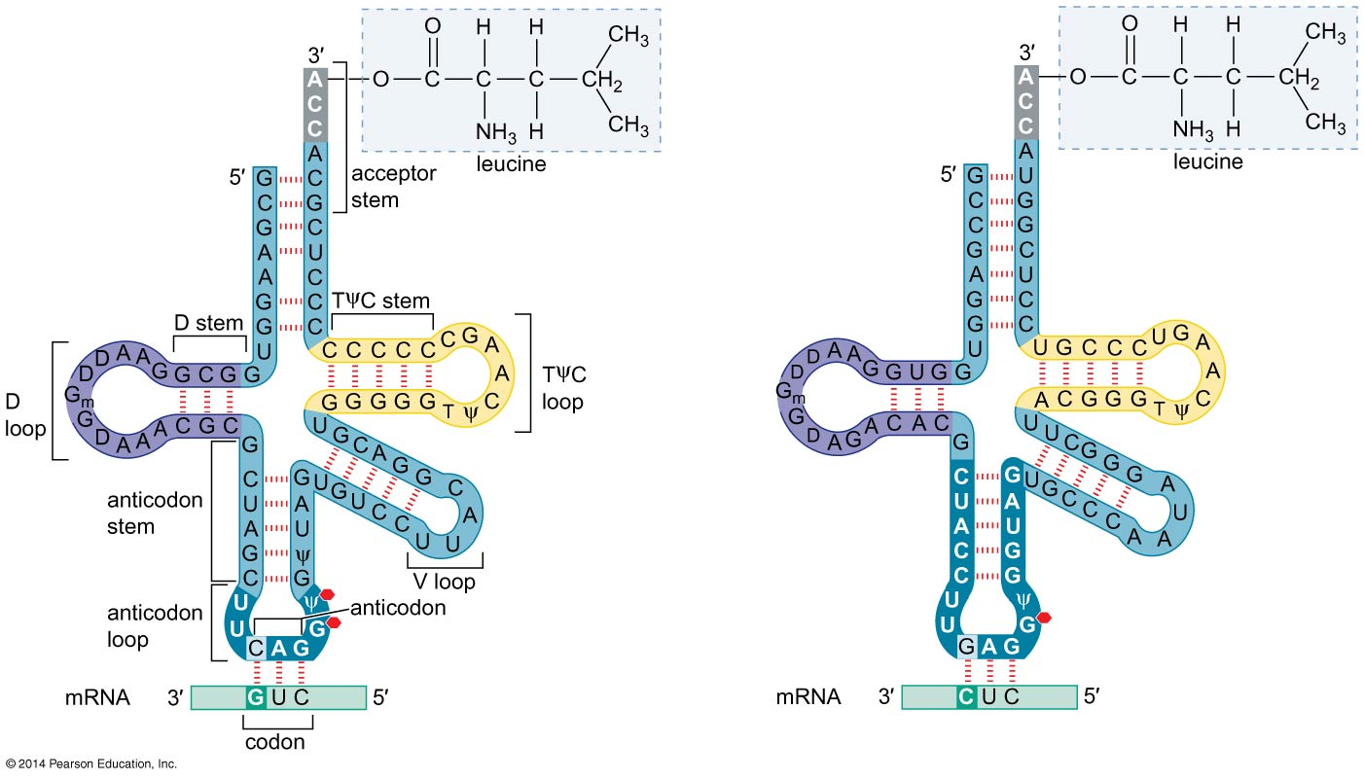
Wobble in the anticodon

Slide 7
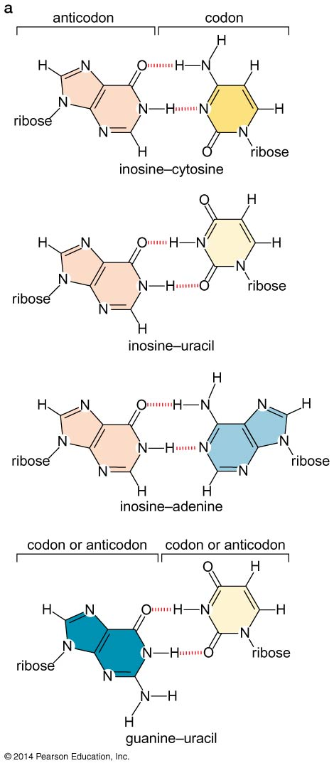
Wobble Rules
Pairing allowed only to those with ribose –ribose distances close to the standard

Slide 8
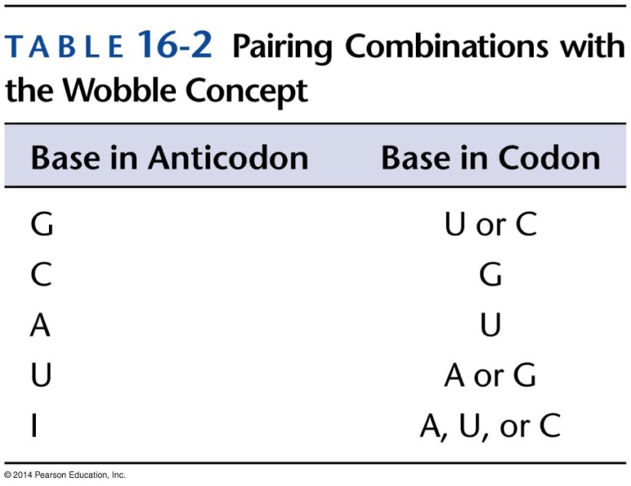
Wobble Rules
A single tRNA can’t recognize 4 different codons
Three codons can be recognized only when inosine occupies the first 5` position of anticodon

Slide 9
Wobble Rules
mRNA UCU UCC UCA
tRNA AGI AGI AGI
tRNA AGG AGG AGU
tRNA AGI AGG AGU

Slide 10
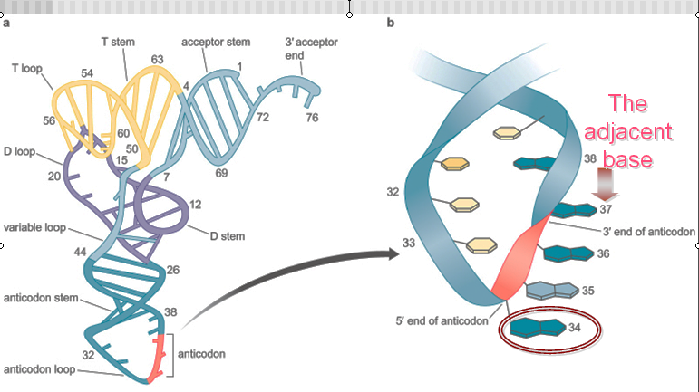
Wobble in the Anticodon
The 3D structure and stacking interaction explains why wobble is seen in the 5` end of tRNA

Slide 11
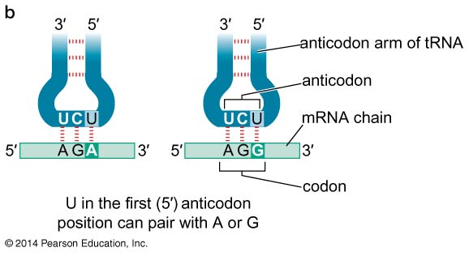
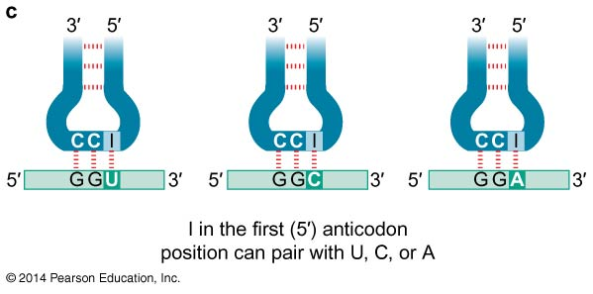
Wobble in the Anticodon

Slide 12

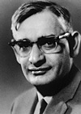
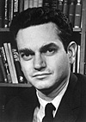
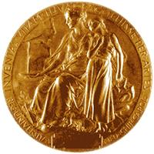
How the Code was Cracked
Achieved by studying protein synthesis in cell-free extracts.
Step by step procedure and collaborative work
1968: Robert Holley, H. G. Khorana and Marshall Nirenberg

Slide 13
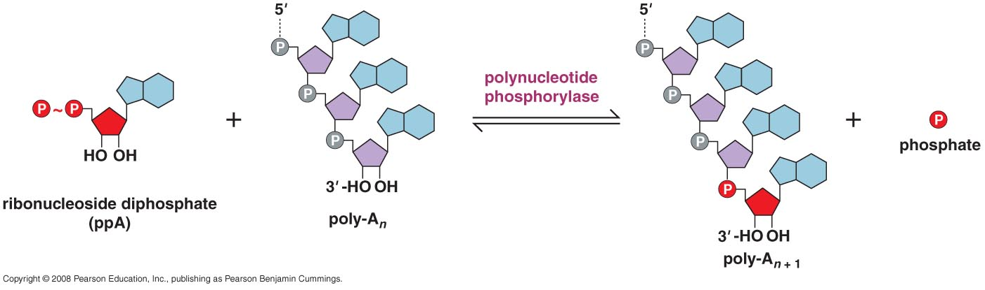
Main reaction

Slide 14
How the code was cracked
Cell-free , protein synthesizing machinery isolated from E. coli.
  Synthetic mRNA containing only one type of base:
  UUU = Phe, CCC = Pro, AAA = Lys, GGG = ? (unstable)
Synthetic copolymers composed of different % of two different bases:
  Pro, Lys (already defined) + Asp, Glu, His, & Thr
  Could not determine exactly which codon specified which amino acid.

Slide 15
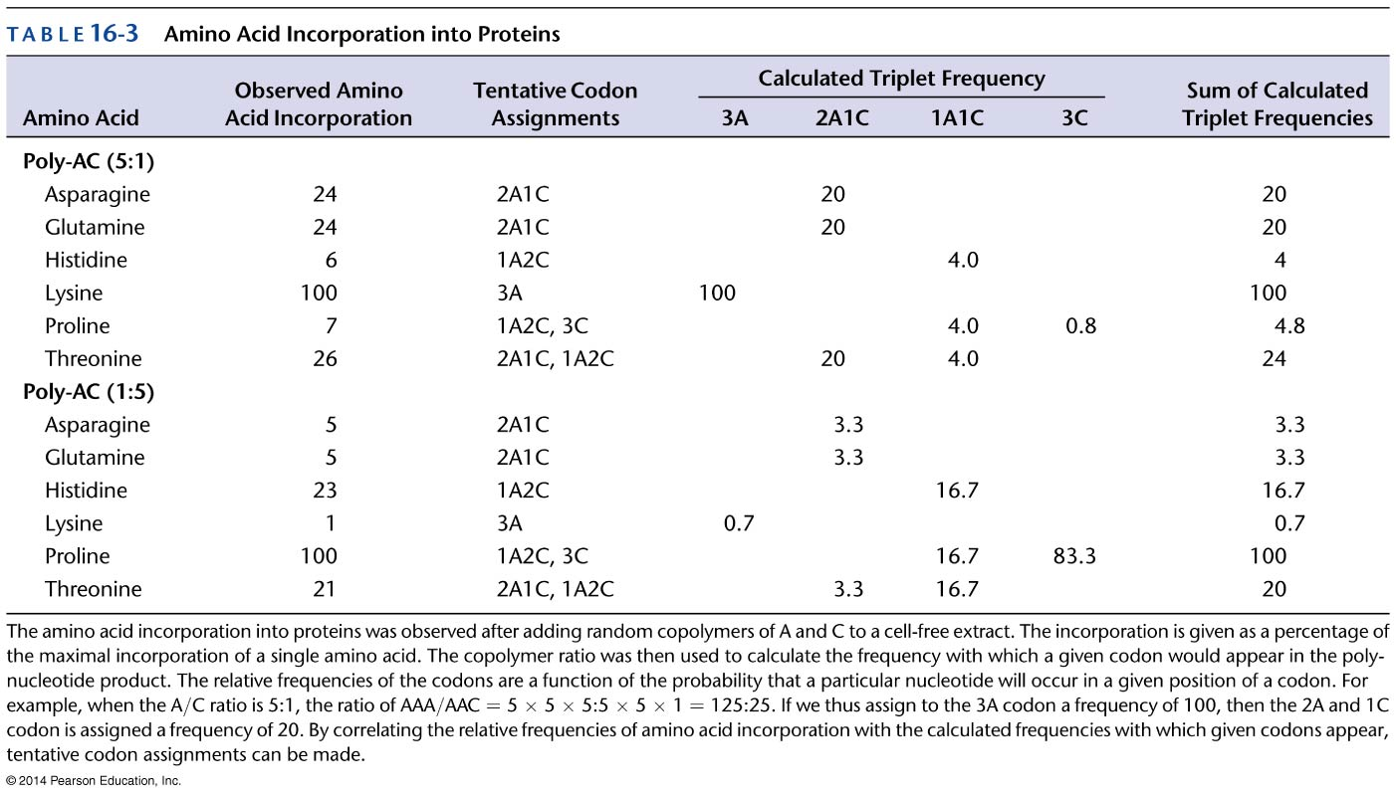
Synthetic copolymers

Slide 16
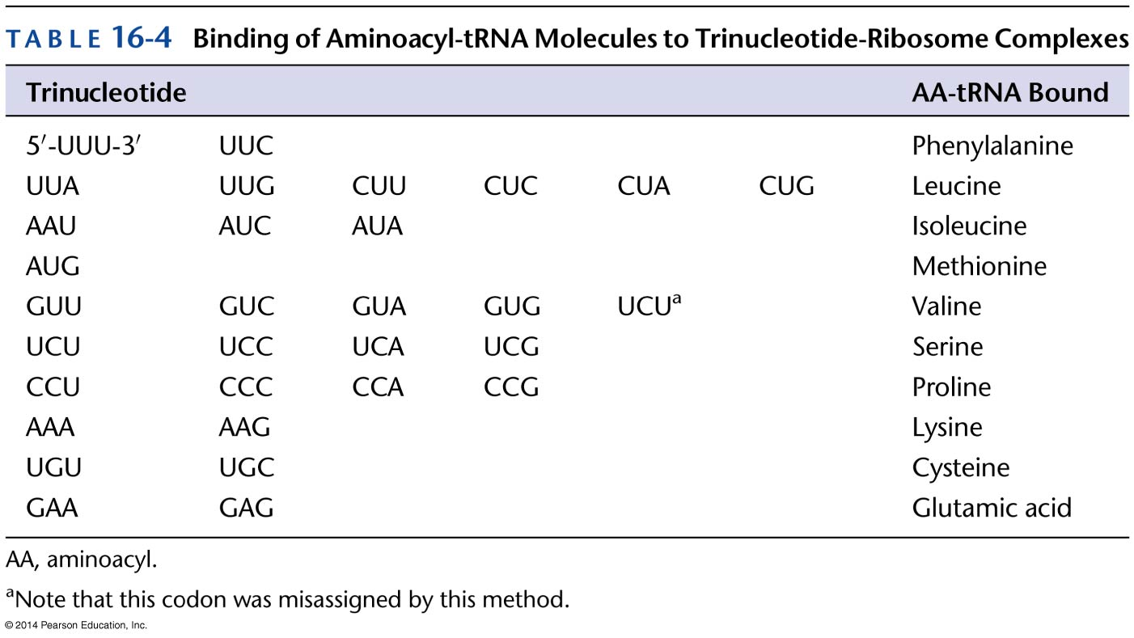
How the Code is Cracked
3- Ribosome binding assays

Slide 17
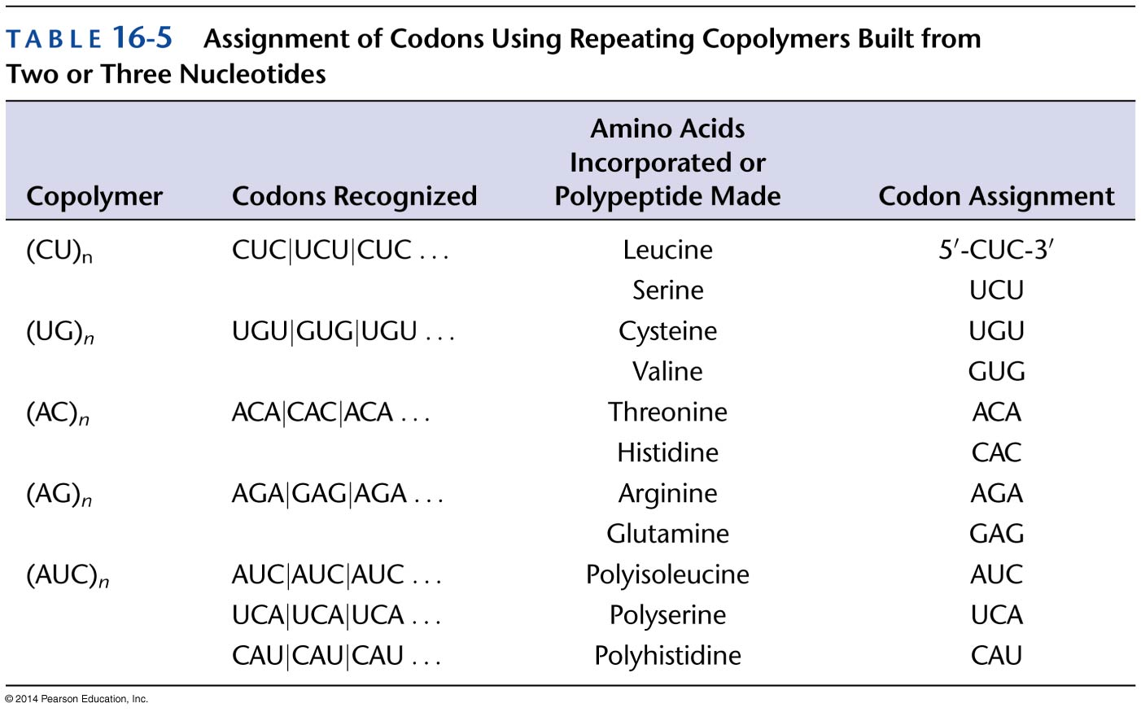
How the Code is Cracked
4- Codon assignment from repeating copolymers

Slide 18
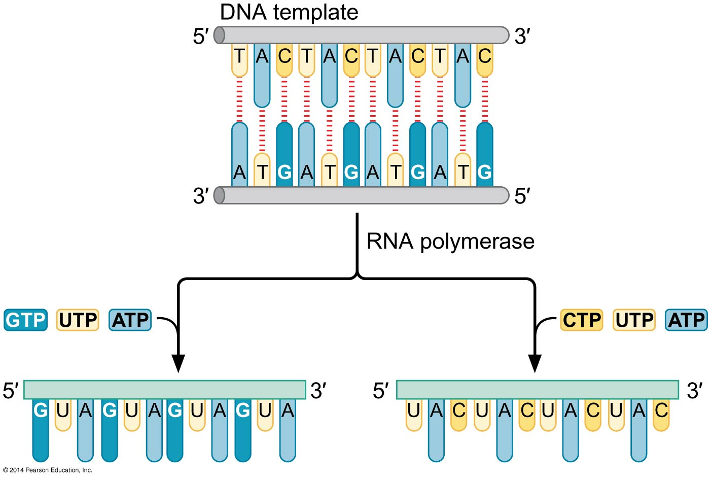
Preparing Oligonucleotides

Slide 19
Three Rules governs the genetic code
Codons are read in a 5` to 3` direction.
Codons are nonoverlapping and the message contains no gaps.
The message is translated in fixed reading frame, which is set by the initiation codon.

Slide 20
Read from 5` to 3` Direction
Poly peptide : NH₂-Thr-Arg-COOH
mRNA :5`-ACGCGA-3`
mRNA :3`-GCAAGC-5`
Poly peptide : NH₂-Arg-Thr-COOH
mRNA :3`-AGCGCA-5`
Poly peptide : COOH-Arg-Thr-NH₂

Slide 21
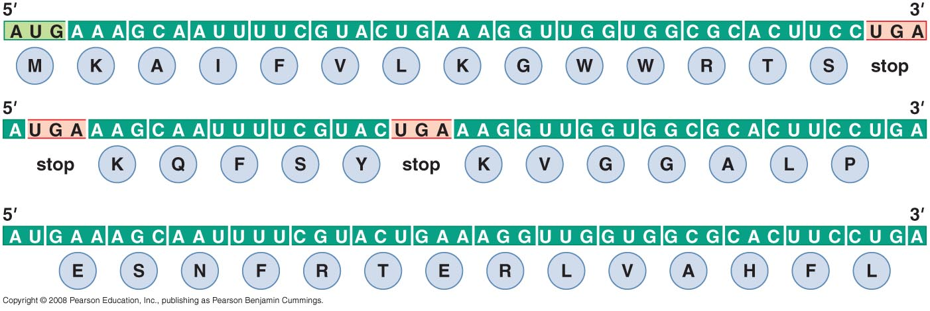
Translation Starts at an Initiation Codon.
  For Prokaryotes is AUG/GUG/UUG Codon
  For Eukaryotes is always AUG

Slide 22
Point Mutation (SNP)
Transition
Transversion
Insertion
Deletion

Slide 23
Sites of point mutation
Coding region mutations
Regulatory mutations
  Promoter
  Regulatory sequence
RNA processing mutation
  Capping or polyadenylation
  Splicing site mutation

Slide 24
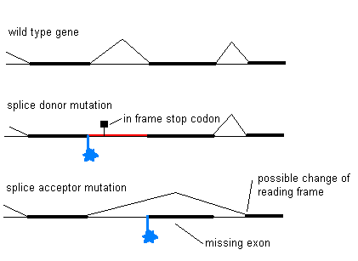
Splicing site mutation

Slide 25
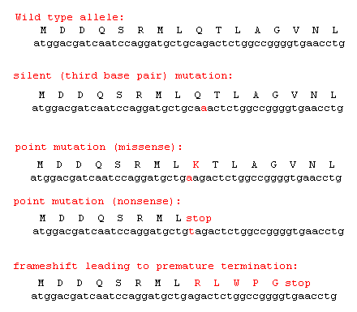
Types of point mutation in the Coding sequence
c
t

Slide 26
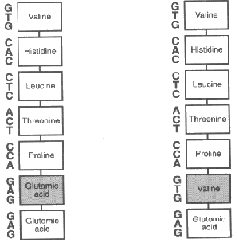
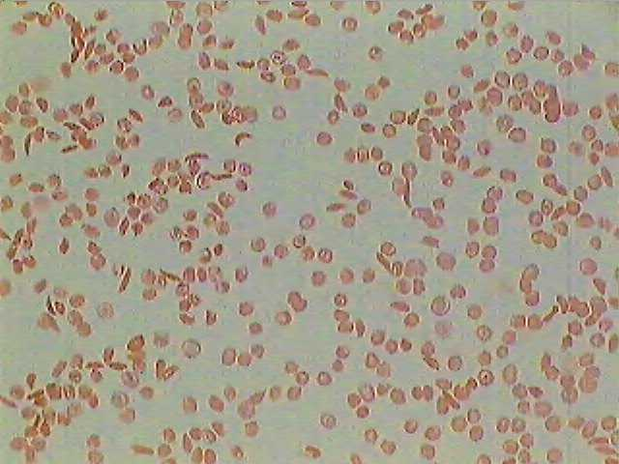
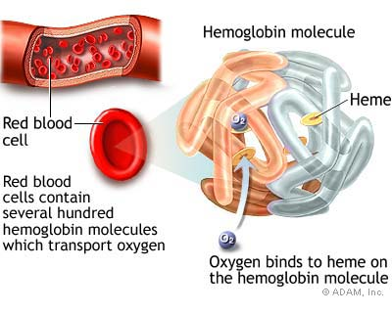
Example of missense mutation sickle cell anaemia
β globin gene (11p15.5)
  Transversion mutation (A→T)

Slide 27
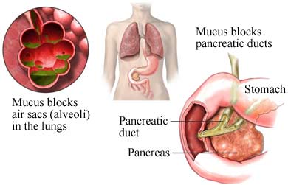
Example of nonsense mutation
Cystic fibrosis
caused by mutations in the cystic fibrosis transmembrane conductance regulator gene (CFTR) on chromosome 7

Slide 28
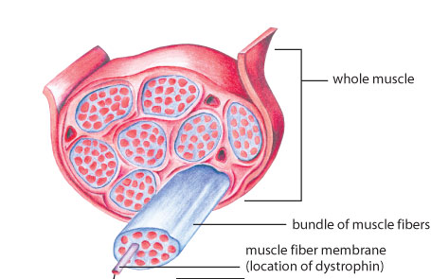
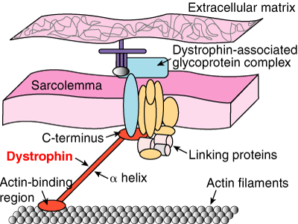
Example of nonsense mutation
Duchenne muscular dystrophy

Slide 29
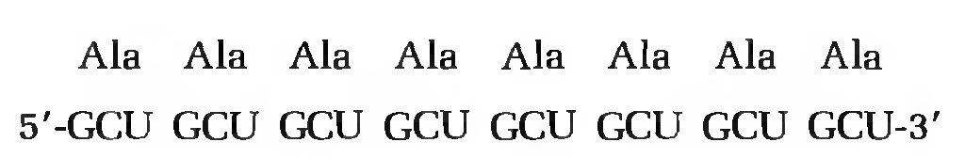
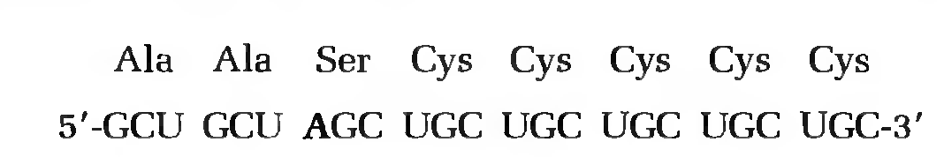
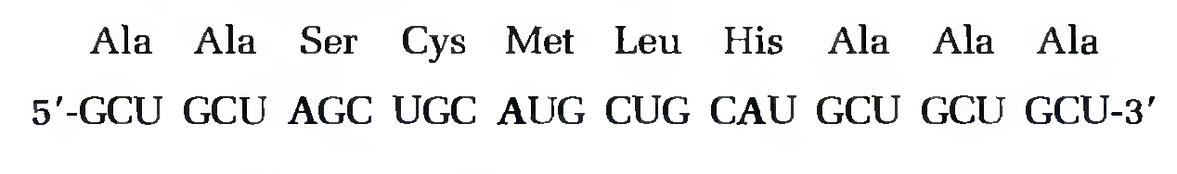
Frameshift mutation
A genetic proof of the code is a units of 3

Slide 30
How to restore a mutation
Direct reversal of mutation:
  Reverse (back) mutation: which change an altered nucleotide sequence back to its original arrangement.
Suppression of mutation
  Intragenic suppression
  Intergenic suppression

Slide 31
I- Reverse (back) mutation
A mutation that precisely restores a mutant DNA sequence to the wild-type DNA sequence.
Base substitution mutations:
  UGG -> UGA -> UGG
  trp -> stop -> trp
Frameshift mutations:
UGG GGG AAA-> UGG GGG GAA A..-> UGG GGG AAA ...
trp gly lys ... trp gly glu ... trp gly lys ...
Insertion mutations:
  precise deletion ("excision") of the added DNA sequence
Deletion mutations:
  cannot be restored by true reversion

Slide 32
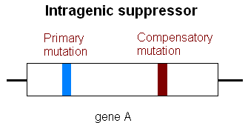
II- suppression mutation a- Intragenic suppression
Occurring within the same gene as the original mutation, but at a different site in this gene

Slide 33
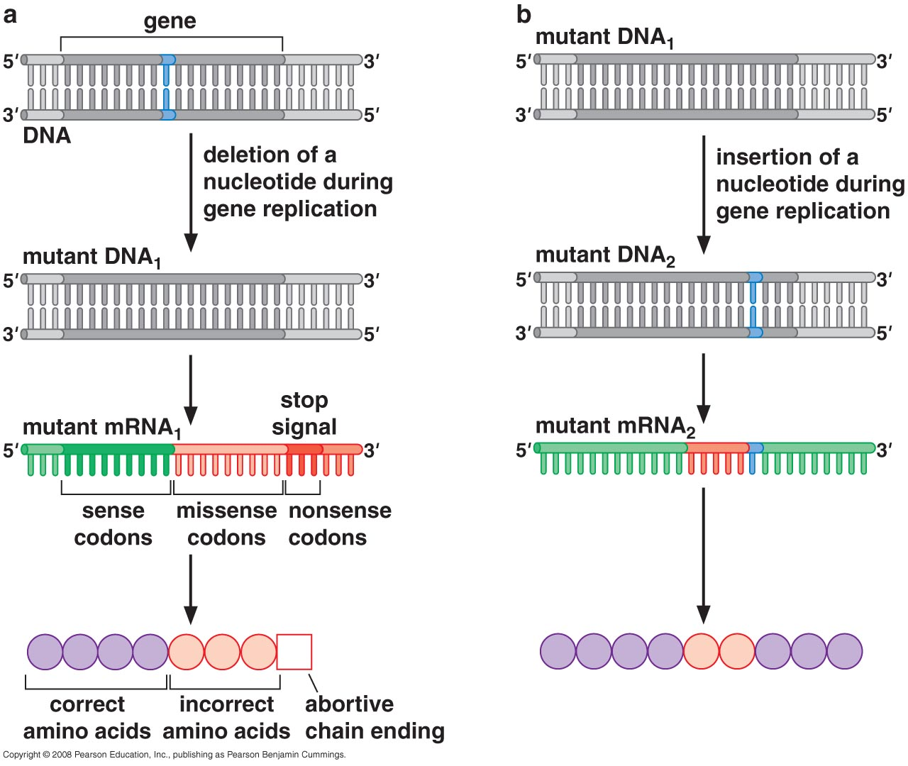
II- suppression mutation a- Intragenic suppression

Slide 34
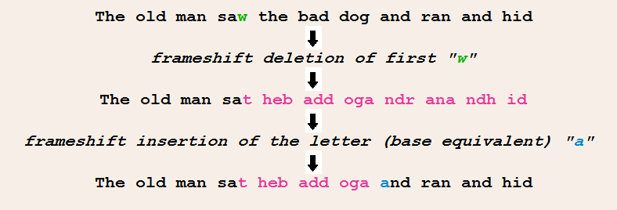
Sentence analog of intragenic suppression

Slide 35
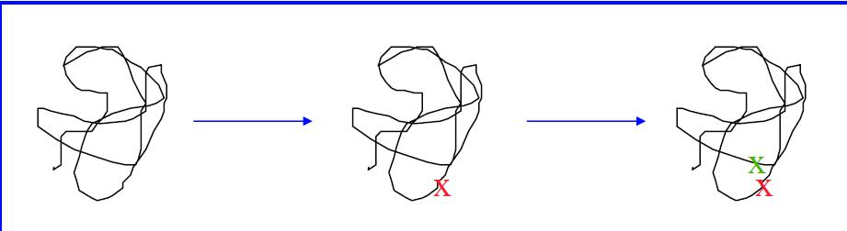
II- suppression mutation a- Intragenic suppression
Mutations can alter the secondary or tertiary structure of a protein. a compensatory amino acid substitution that is distant within the linear sequence can restore a necessary functional or structural feature that was lost due to the first mutation.

Slide 36
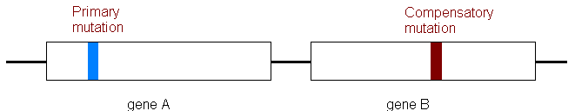
II- suppression mutation b- Intergenic suppression
Mutations occurring in another gene
Genes that cause suppression of mutations in other genes are called suppressor genes.

Slide 37
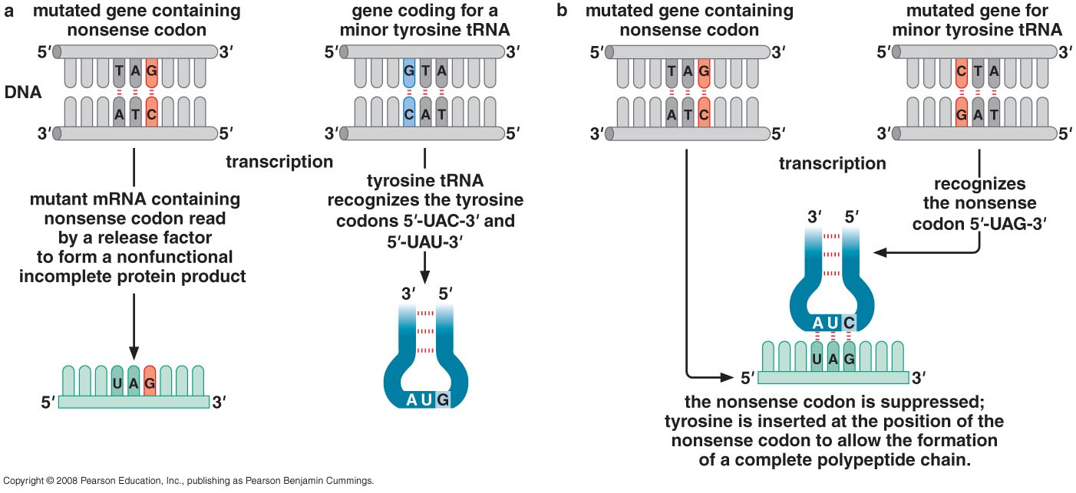
Mutant tRNA is an intergenic suppressor

Slide 38
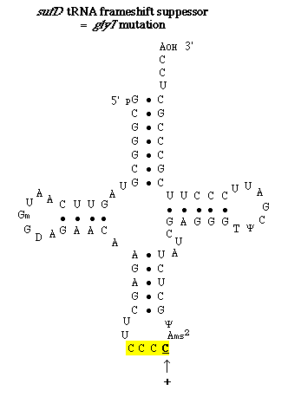
Mutant tRNA is an intergenic suppressor
Framshift suppressors are mutant tRNA molecules that have a 4 base anticodon rather than the normal 3 base anticodon.
Normal AAA CCC GGG
Mutant AAA XCC CGG G
Suppressed AAA XCCCGGG

Slide 39
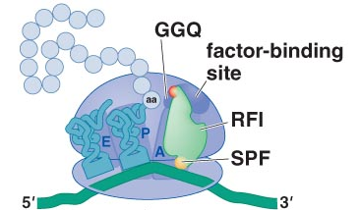
Nonsense Suppressor also Read Normal Termination Signals
competition between suppressor
tRNA and the release factor.
  UAG stop codon → not very common but 50% read by suppressor tRNA
  UAA stop codon → very common only 1-5% read by suppressor tRNA

Slide 40
Efficiency of Suppression
The efficiency of codon-specific suppressors is generally low (<15%) for many reasons:
  Concentration of suppressor tRNA
  Affinity of the suppressor tRNA for the tRNA synthetase
  Affinity of the suppressor tRNA for the ribosome (in competition with RFs in nonsense suppression).

Slide 41
Proving the Validity of the Genetic Code
Frameshift caused by insertion and deletion changed the a.a sequence
Normal
NH2—Lys Ser Pro Ser Leu Asn AIa--COOH
5'--AAA AGU CCA UCA CUU AAU GC--3'
5'--AAA GUC CAU CAC UUA AUG GC--3'
NH2-- Lys Val His His Leu Met AIa—COOH
Mutant

Slide 42
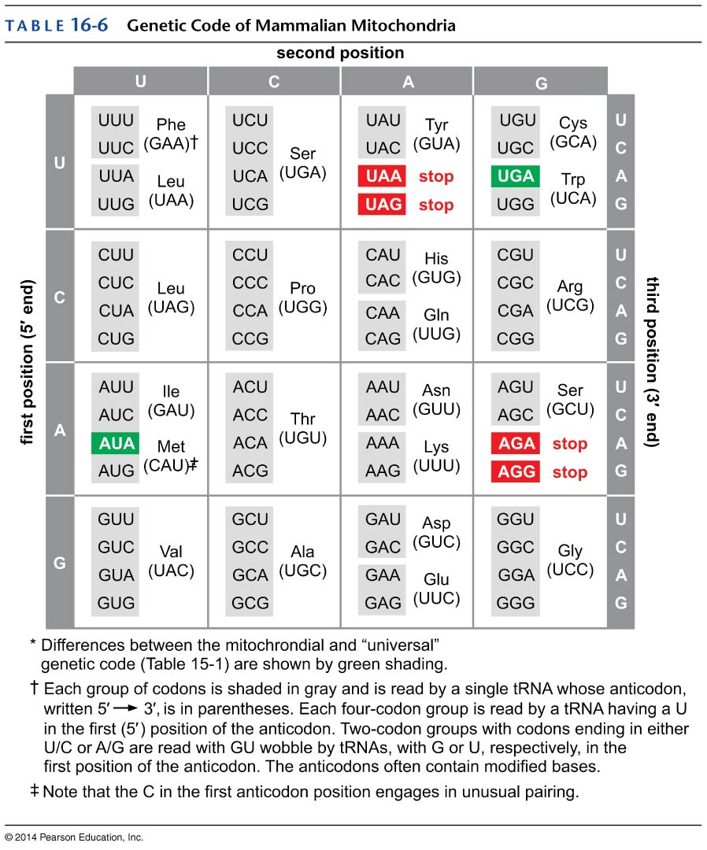
Differences between the universal & mitochondrial genetic codes
UGA is not a stop signal but codes for tryptophan
Internal methionine is encoded by both AUG and AUA
AGA and AGG are not arginine codons but stop codon
In fruit fly mitochondria, AGA and AGG are also not arginine codons but specify serine

Slide 43
Different decoding system
Only 22 tRNAs are present in mammalian mitochondria, compared to 32 tRNAs for “universal” code according to the wobble rules.
Mit. tRNAs have U residue in the 5’ position of their anticodons which can pair with all 4 bases in wobble position.
Exceptions occur also in prokaryotic and some nuclear Eukaryotic genomes
Mycoplasma UGA: Trp instead of stop codon.
Candida Yeast: CUG: Serine instead of leucine.

Slide 44
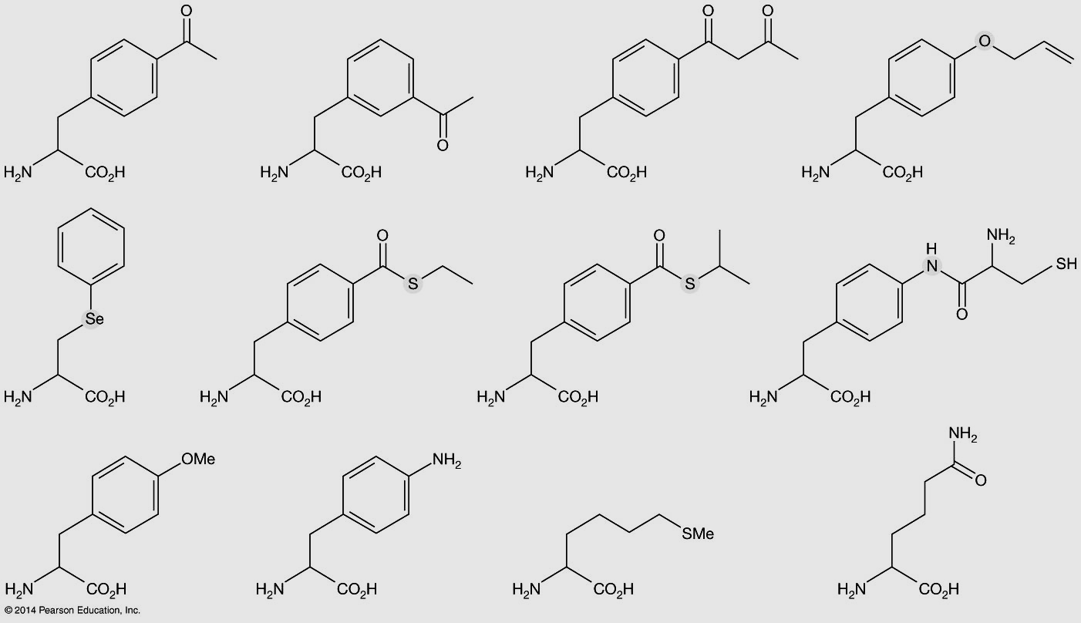
Example of unnatural amino acids developed for incorporation by expanded genetic code.

